Slide 1
News Article Summarisation
Falgunee Warutkar
Prachi Bari
Prachi Ghadge

Slide 2
OBJECTIVE
The aim is to build an automatic news summarization system
Provide the user with a short summary of the news articles

Slide 3
Techniques:
Text Rank Algorithm
Word Frequency Algorithm

Slide 4
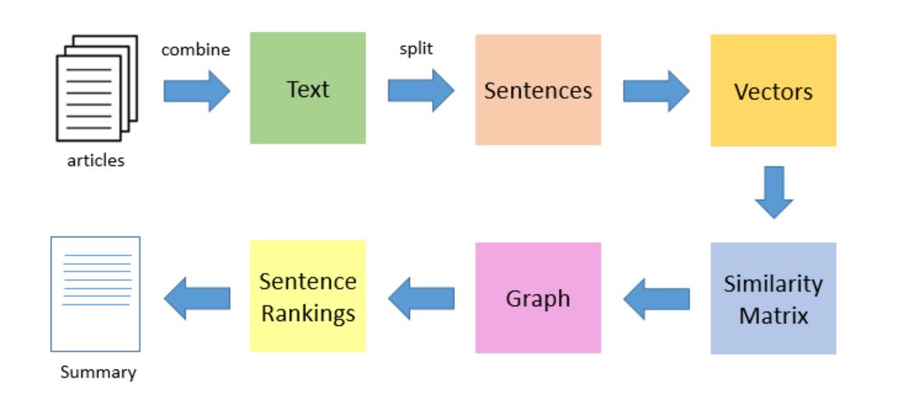
Text Rank Algorithm

Slide 5
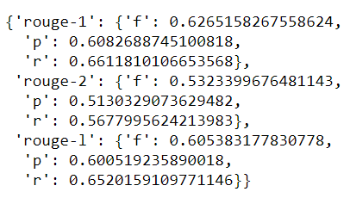
TextRank Algorithm Results
Input article → split into sentences → remove stop words → build a similarity matrix → generate rank based on matrix → pick top 5 sentences for summary.

Slide 6
Implementation
Scrape Data
Store in DB
Extract Data from DB and Summarise the Artcile
Store the Summaries in DB
Display the Summaries in the UI

Slide 7
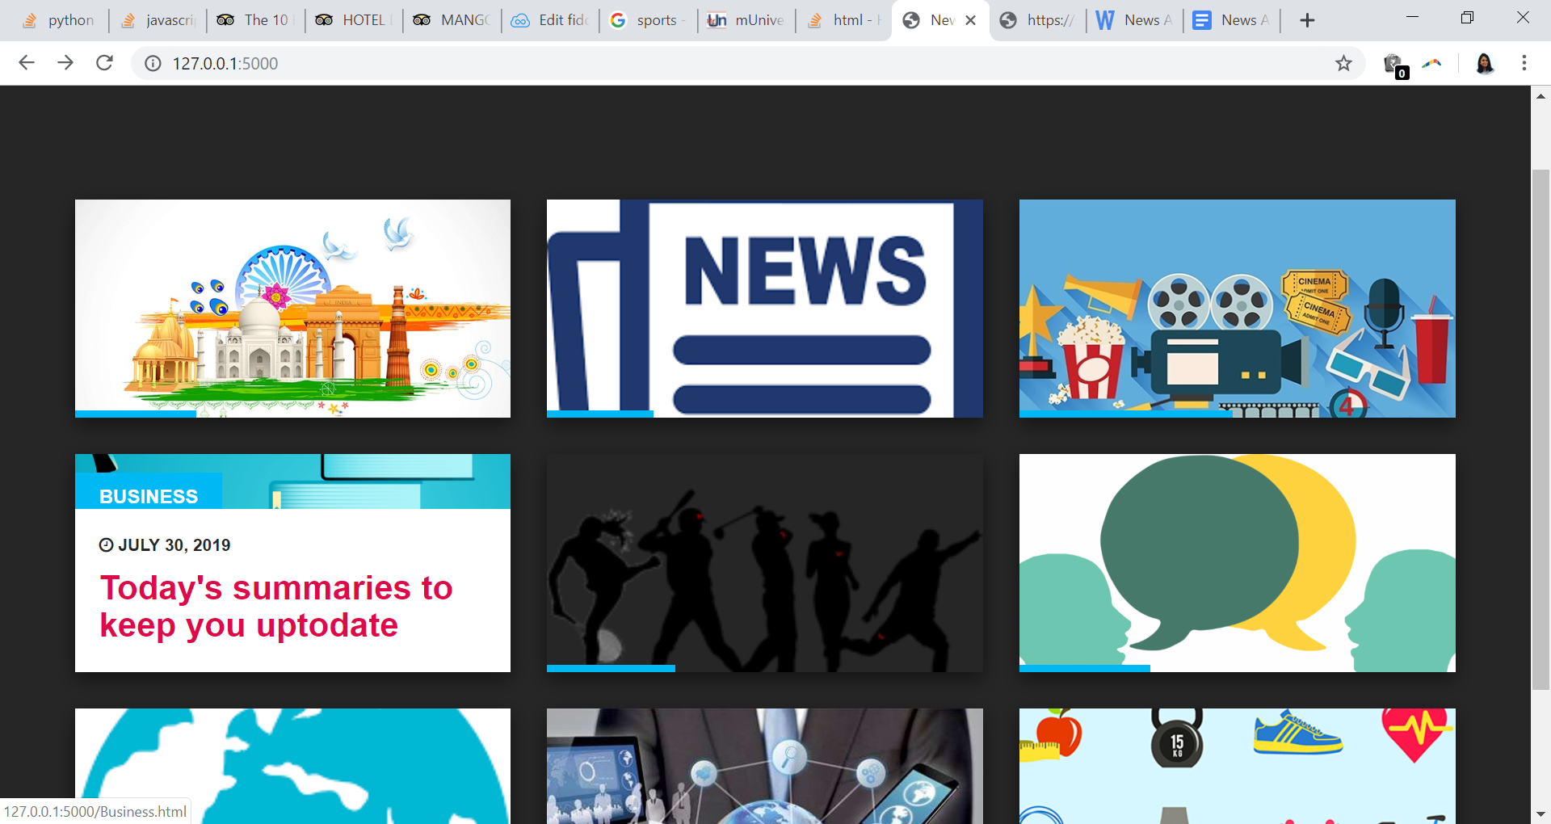
Deployment
Landing Page of the product.
Here we have the major categories users can browse through categories like Nation , Lifestyle , Sports , Business etc. and check the top news in each category by the top News Houses in India.
This product is a News Aggregator as well as News Summariser.

Slide 8
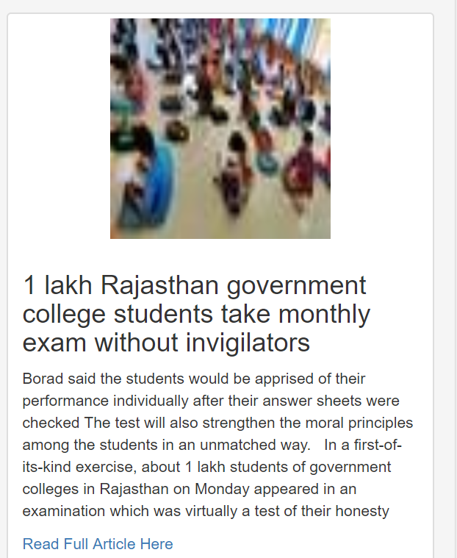
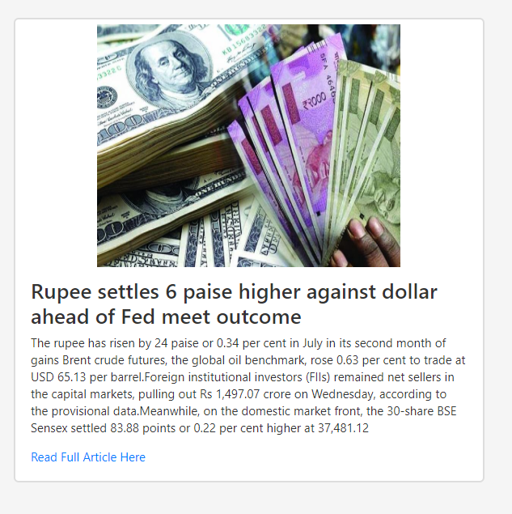
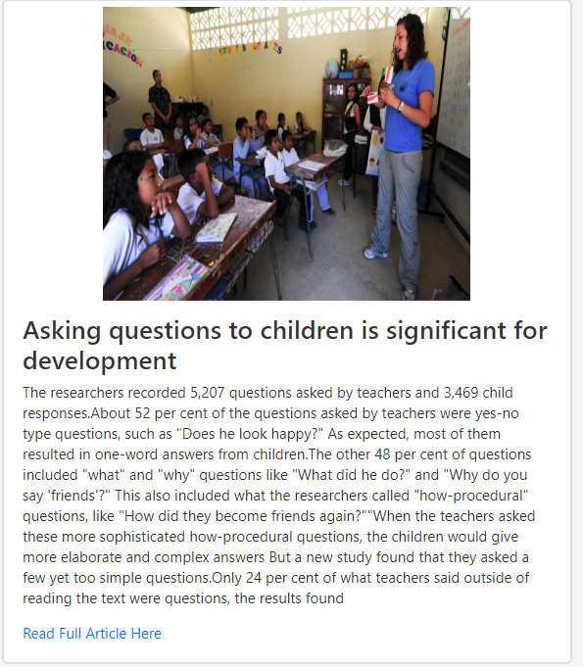
Result

Slide 9
Conclusion
As natural language understanding improves, computers will be able to learn from the information on-line and apply what they learned in the real world. Combined with natural language generation, computers will become more and more capable of receiving and giving instructions. Due to rapid growth of technology and use of Internet, there is information overload. This problem can be solved if there are strong text summarizers which produces a summary of document to help user. Hence there is a need to develop system where a user can efficiently retrieve and get a summarized document. One possible solution is to summarize a document using either extractive or abstractive methods. Text summarization by extractive is easier to build. But text summarization by abstractive technique is stronger because they produce summary which is semantically related but difficult to produce.

Slide 10
Conclusion
Staying aware in today’s world is very crucial
Text Summarization is one of those applications of Natural Language Processing (NLP) which is bound to have a huge impact on our lives.
With growing digital media and ever growing publishing – who has the time to go through entire articles / documents / books to decide whether they are useful or not?
This particular technique in our project helps users get the gist of the article with less reading time
As natural language understanding improves, computers will be able to learn from the information on-line and apply what they learned in the real world

Slide 11
THANK YOU

